Slide 1
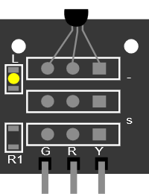
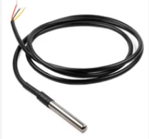
03 18B20 Temperature sensor
L
-
S
+
QC
https://shop.pimoroni.com/products/ds18b20-programmable-resolution-1-wire-digital-thermometer?variant=32127344640083
G R Y
R1
1
2
3

